Slide 1
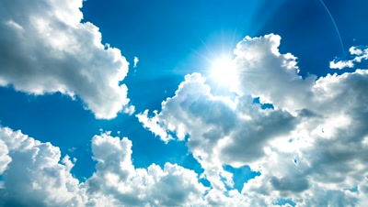
Flood Measurement from a Photo
By
Shaffer, Hoke, Pander & Kuehl Partners

Slide 2




Partners
Clint Hoke
Jamie Shaffer
Jonna Pander
Josh Kuehl

Slide 3

Agenda
Problem Statement
Research
Solution
Issues

Slide 4

Problem: Create a machine model that can detect flood depth from a photo.

Slide 5
Research
Scholarly Articles
Resources
APIs
Libraries
*Full list of research available here

Slide 6







Solution
Latitude and Longitude
Elevation
Local Elevation Flood Prediction
Earth Engine
EXIF
Approximate Flood Depth
Image
Vision AI
True
Depth 4
~ 4 feet
Depth 3
~ 3 feet
AND
VGG16 cNN
Depth 2
~ 2 feet
True
Depth 1
~ 6 inches
Depth 0
No submersion
AND/OR
True
Depth 4
~ 4 feet
Depth 3
~ 3 feet
Depth 2
~ 2 feet
Depth 1
~ 1 foot
Depth 0
No submersion

Slide 7
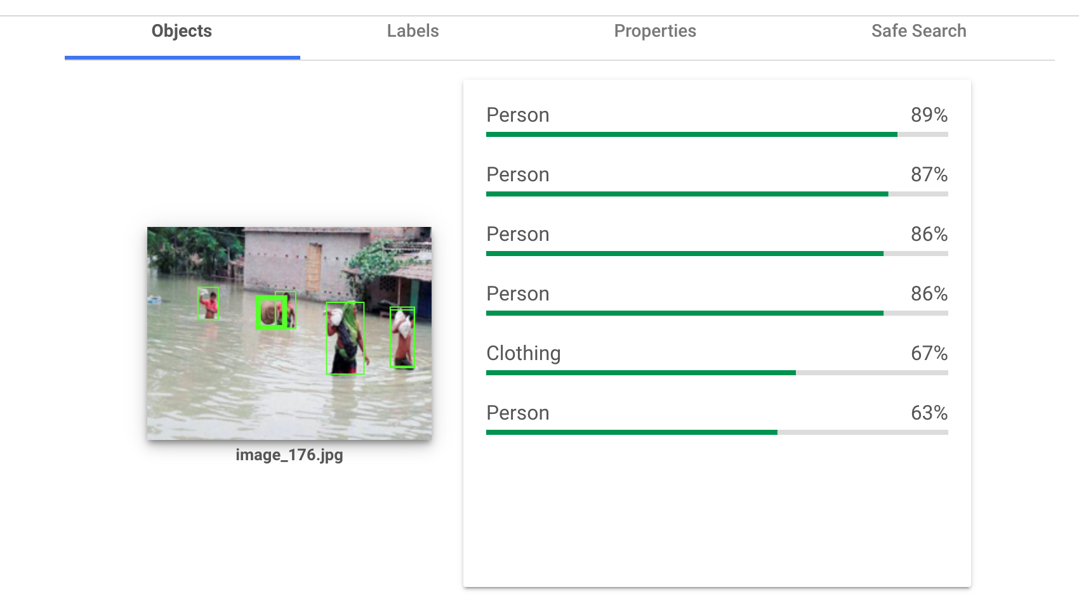
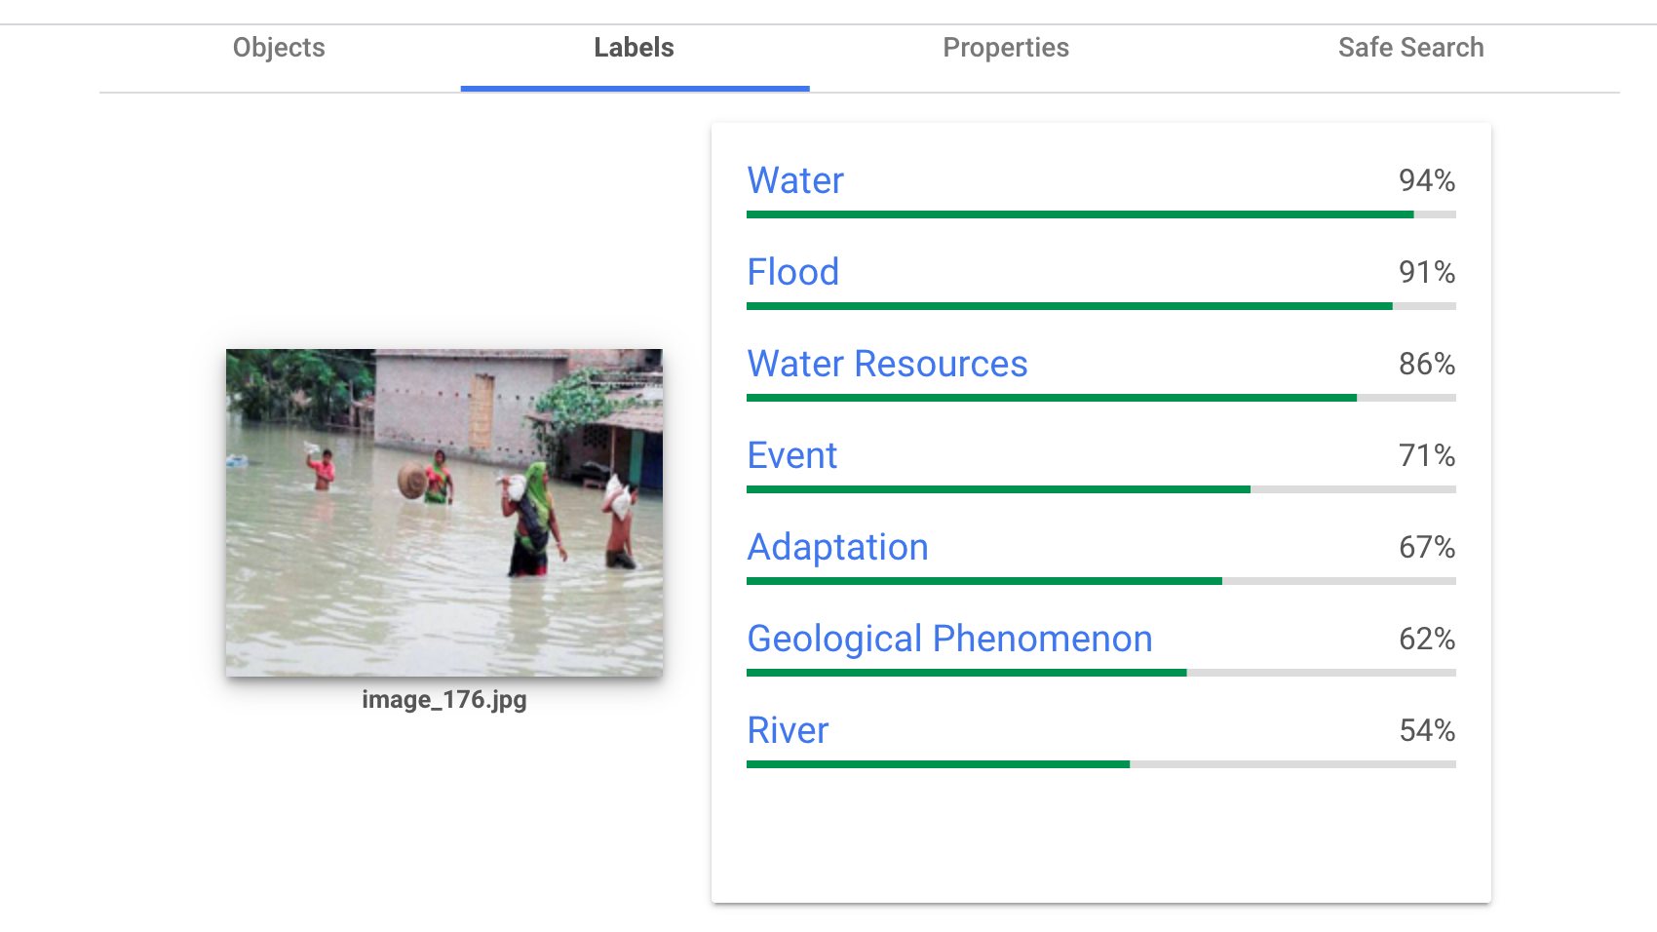
Google Vision AI
Paid Service
Detect objects automatically
Data labeling service
Image pre-processor
API was used to run batches of images

Slide 8
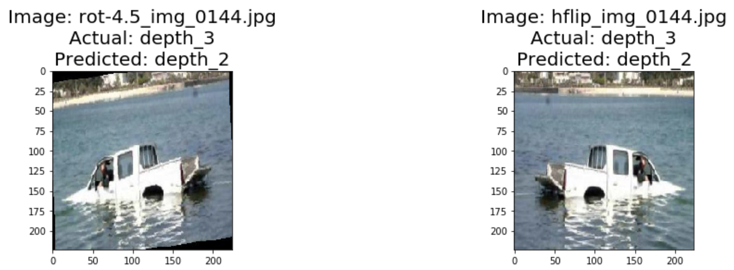
Image Augmentation

Slide 9
Results
Truck Model
People Model
Exact Accuracy: 32%
Tolerance(+/-1) Accuracy: 80%
Most accurate at depths 0 - 2
Exact Accuracy: 25%
Tolerance(+/-1) Accuracy: 60%
Most accurate at depths 0 and 4

Slide 10
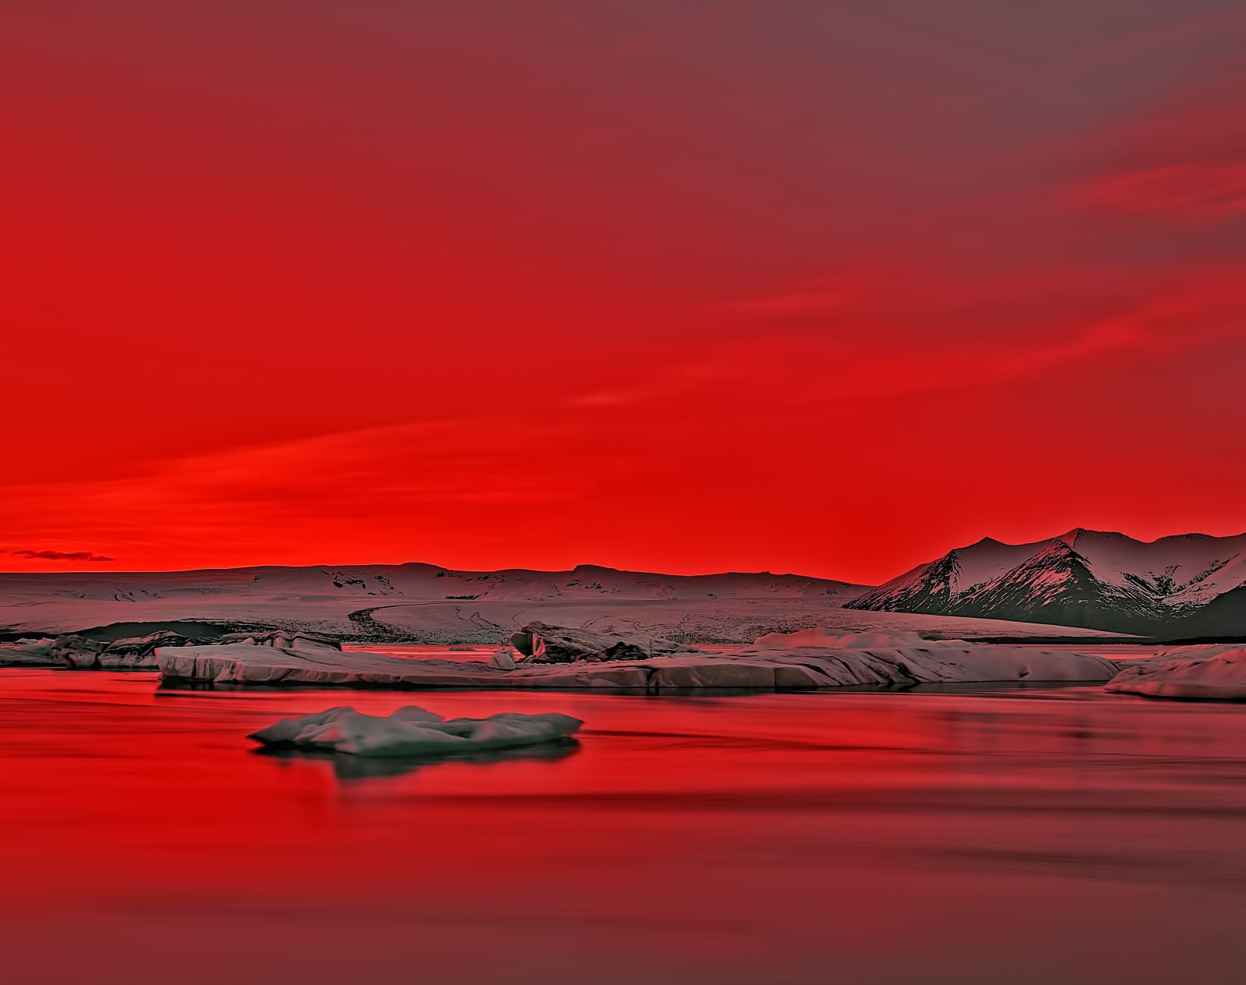
Issues
People can swim
Shortage of training data
Bow wake
Personal computer processing power
Complex images
Micro terrain
Time constraint
Definition of levels

Slide 11

Questions

